Slide 1

Knowledge and Data Engineering
Project
Movie Recommendation
Nikita Aksjonov
Nikos Kessidis
Bar Melinarskiy
Konstantinos Zavantias
Αυτή η φωτογραφία από Άγνωστος συντάκτης με άδεια χρήσης CC BY-SA-NC
Notes:
Bar

Slide 2
PROJECT OBJECTIVE
Personalized Movie Recommendation System
Direct Interaction with Knowledge Graph
Semantic Web Technologies Integration
User-Friendly Web Interface
Notes:
Bar

Slide 3







TECHNICAL IMPLEMENTATION
Notes:
Bar

Slide 4



DATA MINING
Remote endpoint
SPARQLWrapper
Notes:
Bar

Slide 5
DATA MINING
Query Strategies
Temporal
Popularity
Leading Studios
Remote endpoint
Retrieve movies released from 1990 to the present
Fetch well-known movies by title
Retrieve movies based on the most common production companies (ranked by the number of movies produced)
SPARQLWrapper
Notes:
Bar

Slide 6



Creation of Knowledge Graph
Data Preprocessing: Clean corrupted values (e.g., typos) and standardize names (e.g., "USA" to "United States of America")
Triple Creation: Handle literals by data type, separating strings, integers, dates, and object literals
Ontology Creation: Define domain, range, and subClassOf relationships between entities in the graph
Export RDF data into a Turtle (TTL) file
RDFLib
Notes:
Kostas

Slide 7
Knowledge Graph Statistics
ATTRIBUTES
Property | Value
data size | 322 MB
# of films | 32,050
# of triples | 90,515
# of subjects | 123,036
# of predicates | 32
# of objects | 34,618
Language
Title
Genre
Box Office
32,050
841
6,889
30,338
Release Year
Actors
Producer
10,837
25,644
16,797
directors
Abstract
Duration
Writers
25,556
32,050
28,039
19,381
Notes:
Kostas

Slide 8
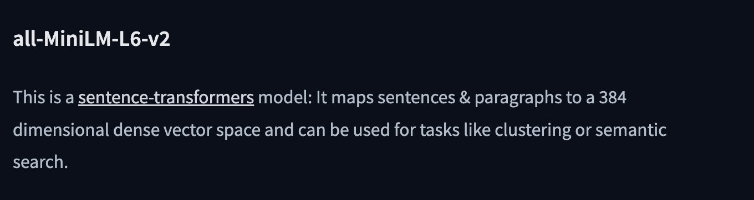
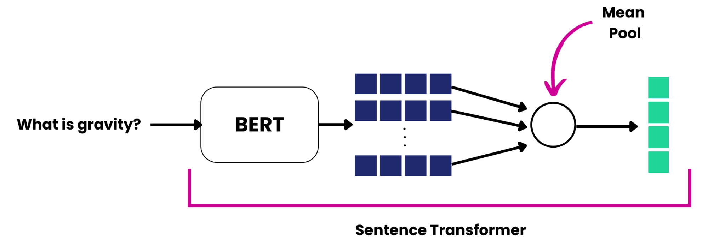
PLOT EMBEDDING
Movie descriptions were converted into embeddings using SentenceTransformer, enabling calculation of similarity between movies based on semantic content.
Notes:
Nikita

Slide 9
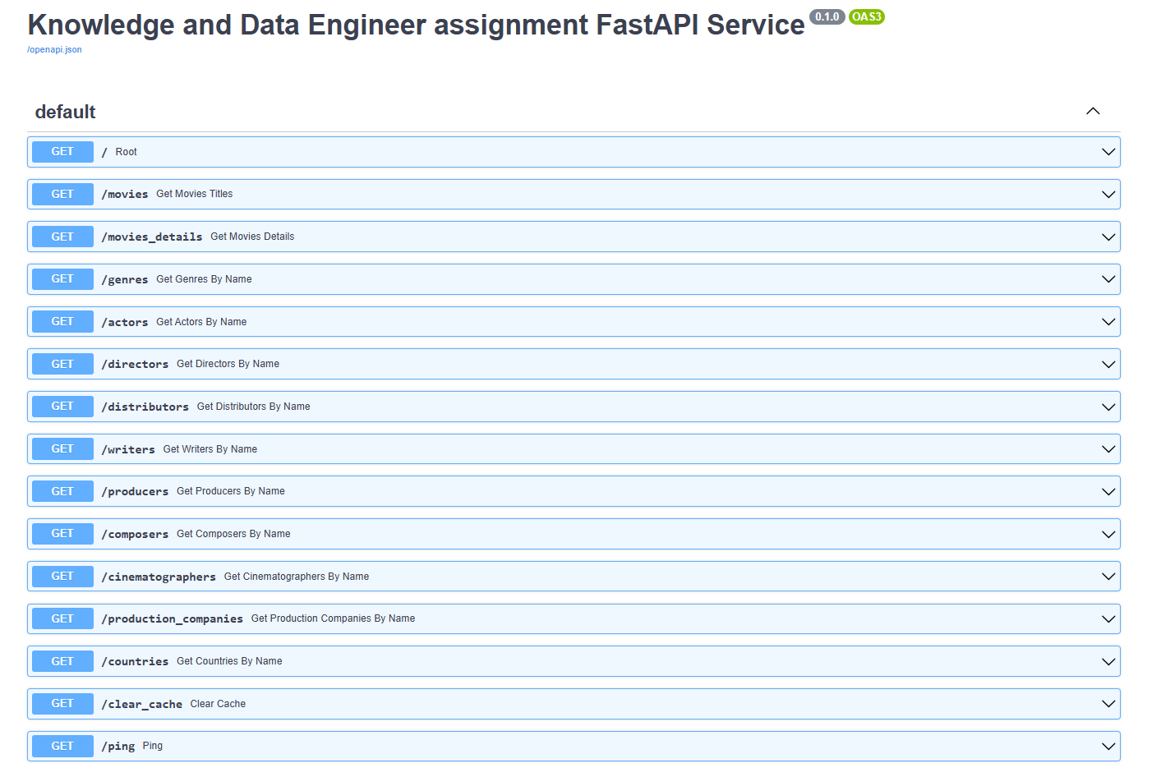
BACKEND
Asynchronous REST Service: Built with FastAPI and SPARQLWrapper for high performance and scalability.
Caching Mechanism: Integrated Redis for faster data retrieval and improved performance.
Database Independence: Decouples the UI from the chosen database, enabling flexibility and adaptability.
Notes:
Bar

Slide 10
FINDING SIMILAR MOVIES
PREFIX dbo: <http://dbpedia.org/ontology/> PREFIX dbr: <http://dbpedia.org/resource/>
SELECT DISTINCT ?movie ?title ?plotEmbedding ?similarityScore
WHERE {{
BIND({movie_uri} AS ?targetMovie)
?movie rdf:type dbo:Film ;
rdfs:label ?title .
OPTIONAL {{ ?movie dbo:plotEmbedding ?plotEmbedding . }}
OPTIONAL {{
?movie dbo:genre ?genre .
?targetMovie dbo:genre ?genre .
BIND(10 AS ?genreWeight)
}}
OPTIONAL {{
?movie dbo:starring ?actor .
?targetMovie dbo:starring ?actor .
BIND(6 AS ?actorWeight)
}}
OPTIONAL {{
?movie dbo:director ?director .
?targetMovie dbo:director ?director .
BIND(5 AS ?directorWeight)
}}
BIND(COALESCE(?genreWeight, 0) +
COALESCE(?actorWeight, 0) +
COALESCE(?directorWeight, 0) AS ?similarityScore)
FILTER (?movie != ?targetMovie)
}}
GROUP BY ?movie ?title ?similarityScore
HAVING (?similarityScore > 0)
ORDER BY DESC(?similarityScore)
LIMIT {self.limit}
Fetch properties of a target movie given its URI
Calculate weighted counts for shared properties (e.g., genres, actors)
Select similar movies with score > 0
Notes:
kostas

Slide 11
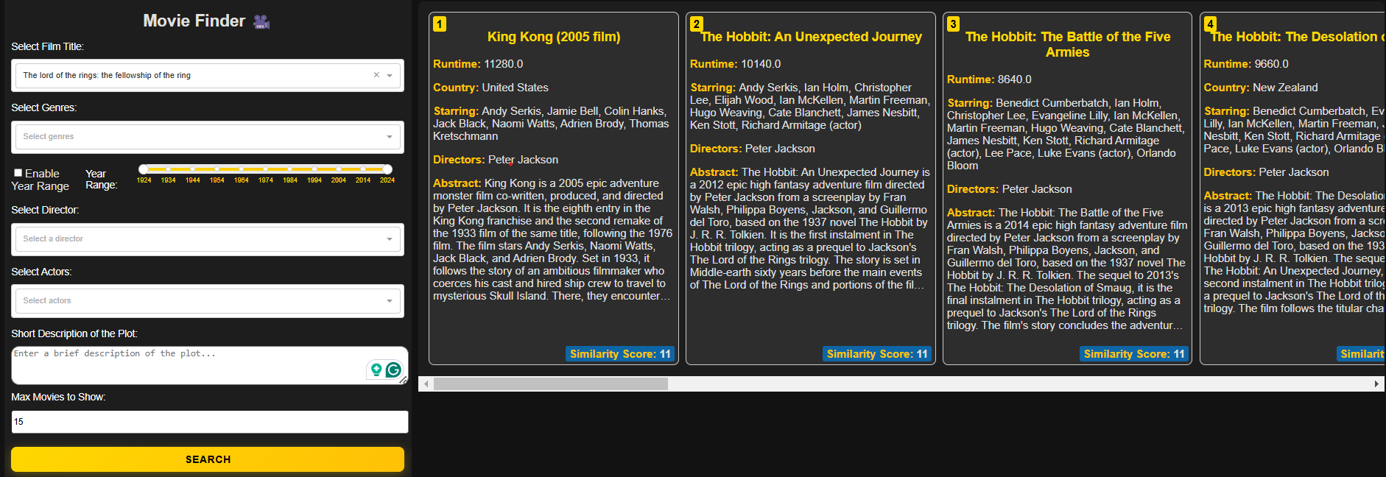
UI
Notes:
Nikita

Slide 12




Performance metrics
Specifications
Metrics
6-core CPU, 3.6 GHz
16GB RAM
Windows 10 OS
CPU usage
Memory usage
Response time Rest/UI
Notes:
Nikos

Slide 13
Performance metrics
Max. movies shown \ Metrics | CPU | Memory | Time (Rest) | Time (UI)
1 movie | 5% | 250 MB | <50 ms | 200 ms
5 movies | ~5% | 300 MB | 50 ms | 200 ms
15 movies | 5-10% | 400 MB | <100 ms | ~300 ms
Notes:
Nikos

Slide 14
LIMITATIONS
Multi-
lingual Support
Dynamic Input
Multi-
Similarity
Complex Similarity Measure & Dataset
Notes:
kostas

